Slide 1
Invoice Total Calculator
Made by: Rohit Shinde
This project is a part of the mentorship program for Data Science and encompasses the basic learnings of the subject and industrial applications of it.

Slide 2
The problem statement
The problem statement states that sometimes as a business requirement, people have to calculate the total value of transactions being done through inspecting the invoice PDFs.
This would usually require a dedicated employee to go through all the concerned Invoice PDFs and calculate the grand total.
We aim to automatize this process by creating a tool which will perform the task of manual calculation for us.

Slide 3
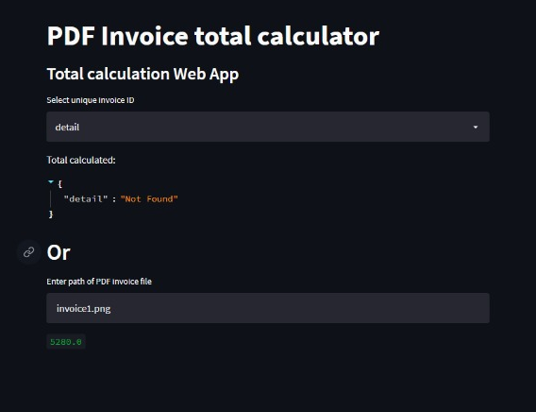
Solution and conclusion
We have created a tool which calculates the total amount present in any given invoice PDF file
Libraries used: FastAPI, Pandas, PIL, pdf2image, etc

